Slide 1

INVISIBLE CHIP TRACKER
MARKETING PROJECT
PRESENTED BY: AQSA HUSSAIN DEPARTMENT: MANAGEMENT STUDIES

Slide 2
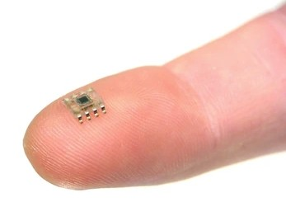
INVISISBLE CHIP TRACKER
Invisible Chip Tracker - that detect or tracks a person location

Slide 3


The purpose of tracking system is to determine the location or direction of a target. An ideal tracking system would maintain contact and constantly update about the target location. The main purpose of inventing this chip is about the kidnapping cases occur now-days in Pakistan.
The rate of kidnapping children is severe as well kidnappers also target adults.
This chip is for every age of person.
OBJECTIVE

Slide 4


PROCESS
Download the application in your mobile.
Login the tracker application with the tracker ID that are written in invisible chip tracker.
After login, make sure to allow location access.
DOWNLOAD APP
LOGIN
LOCATION ACCESS
TRACKER ID

Slide 5







FEATURES
NO AGE LIMIT
Everyone use this invisible chip easily, there is no age limit related to this chip.
EASY TO USE
This chip is very easy to use. We control it through the app, all the activation and the deactivation options present in the app.
INVISIBLE
This chip is transparent and become invisible when it stick to skin. No one can see this chip neither any electronic machine will detect it.

Slide 6





FEATURES
LOCATION TRACKER
Invisible chip is a location tracker that will track the location of the target and constantly update about the target location by the help of app.
STICK TO SKIN
This chip is stick to the skin with adhesives or spirit gum which is a go-to adhesive. It is water-proof but can easily be removed with an acetone-based remover.

Slide 7




3 P'S OF
MARKETING :
PRICE:
THE PRICE WILL BE LOW ENOUGH SO THAT ANYONE CAN AFFORD
PROMOTION: THROUGH FACEBOOK, INSTAGRAM AND GOOGLE
PURCHASE: THROUGH ONLINE WEBSITE OR MOBILE SHOPS.

Slide 8
THANK YOU

